Slide 1

Financial Risk Management
Spring 2016
Dr. Ehud Peleg
Credit VaR – Normal Copula Factor Model

Slide 2
Credit VaR Agenda
VaR for Independent Loans
Simulating Dependent Loans
Copula Factor Model
Closed-form solution
Extensions through simulation
Application to capital requirements

Slide 3
Credit VaR for Uncorrelated Loans
A bank has 100 loans of $15 million each. The probability of default (PD) of each loan is 2.5%. In case of default there is no recovery. Loan defaults are independent of each other.
What is the Expected Loss (EL) on the portfolio?
EL = 100*15*2.5% = $37.5

Slide 4
Credit VaR for Uncorrelated Loans (Example – Cont.)
What is the VaR 96% of the portfolio?
The probability of K loans defaulting is given by the Binomial Distribution
P(K loans default) = BINOMDIST(K, 100,2.5%,0)
P(# defaults ≤ K) = BINOMDIST(K, 100,2.5%,1)
Excel gives us
the following values:
There is 96% that 5 loans
or less will default.
Num Defaults | Cumulative Prob
0 | 0.08
1 | 0.28
2 | 0.54
3 | 0.76
4 | 0.89
5 | 0.96
6 | 0.99

Slide 5
Credit VaR for Uncorrelated Loans (Example – Cont.)
VaR-96% is therefore: 5*15 = $75M, or 5% of the portfolio value.
5% is called Worst Case Default Rate (WCDR)
The Unexpected Loss VaR 96% is equal to 75-37.5 = 37.5 or 2.5% of the portfolio value.

Slide 6
Binomial to Normal
The Central Limit Theorem tells us that at the limit the Binomial will tend to Normal.
Assume a portfolio of N equal size loans, with total value of V.

Slide 7
Binomial to Normal - Example
In our example:
What is the 96 percentile?
UL VaR_{96%} is 78.5 – 37.5 = 41

Slide 8
Binomial to Normal - Example
What would happen if we had the same size portfolio with 1000 loans?
What is the 96 percentile?
UL VaR_{96%} is 50.5 – 37.5 = 13

Slide 9
Limit of Independent Case
As N increases, the variance of the loss decreases, and eventually we are almost guaranteed Loss=Vp.
The VaR tends to the mean, and the Unexpected Loss VaR goes to zero.

Slide 10
Simulating Defaults
First, we look at one loan:
To simulate a loss on one loan with probability of default = PD, we can sample from a uniform, V_{i}~U[0,1], and count as default if V_{i}<PD
We can alternatively sample from a Normal distribution, U_{i}~N(0,1) and count as default if U_{i}<N⁻¹(PD)

Slide 11
Simulating VaR for Independent Loans
Num=1000 #Number of loans
Size=15 #Dollar size of each loan
PD=0.025 #PD for one loan
alpha=0.95 #VaR alpha
N=10000 #Number of iterations
Iter_loss = array (0, dim=c(N)) #Distribution of losses per iteration
for (iter in 1:N) {
U = matrix(rnorm(Num,mean=0,sd=1), 1, Num) #Generate U_i
Default = (U<qnorm(PD)) #Every loan, every iteration, did it default
loan_loss = Default*Size #Total loss on each loan for this iteration (assuming LGD is 100%)
Iter_loss[iter] = sum(loan_loss) #Total loss for this iteration
}
hist(Iter_loss) #Histogram of losses over iterations
EL = mean(Iter_loss) #Expected loss
VaR = quantile(Iter_loss, alpha) #VaR

Slide 12
Independent Loans

Slide 13
Normal Copula Factor Model
We can generate a set of N correlated variables with standard normal distribution using a Factor Model.
We generate N+1 independent standard normal variables: the common factor F, and N idiosyncratic components Z_{i}
Generate new variables, U_{i} as:
They have standard normal distributions and correlation between U_{i} and U_{j} is a_{i} a_{j} – show this.

Slide 14
Normal Copula Factor Model
We consider a case where all
U_{i} is also distributed normally: U_{i}~N(0,1)
The correlation between every two latent variables (U_{i}) is ρ
Count as default if

Slide 15
Simulating VaR for Correlated Loans
Num=1000 #Number of loans
Size=15 #Dollar size of each loan
PD=0.025 #PD for one loan
rho = 0.15 #Correlation between latent variables
alpha=0.95 #VaR alpha
N=10000 #Number of iterations
Iter_loss = array (0, dim=c(N)) #Distribution of losses per iteration
for (iter in 1:N) {
F = matrix(rnorm(1),1,Num) #One F Factor value per iteration
Z = matrix(rnorm(Num,mean=0,sd=1), 1, Num) #idiosyncratic errors for all loans
U = sqrt(rho)*F + sqrt(1-rho)*Z #Generate the U_i for all loans
Default = (U<qnorm(PD)) #Every loan, every iteration, did it default
loan_loss = Default*Size #Total loss on each loan for this iteration (assuming LGD is 100%)
Iter_loss[iter] = sum(loan_loss) #Total loss for this iteration
}
hist(Iter_loss) #Histogram of losses over iterations
EL = mean(Iter_loss) #Expected loss
VaR = quantile(Iter_loss, alpha) #VaR

Slide 16
Correlated Loans

Slide 17
Closed Form Solution
If we assume all loans are of same size, L, with same PD and same LGD we can reach a closed form solution
For a given F, rewrite the condition of default as:
Given that Z_{i} is standard normal, the portion of loans that default conditional on F is:

Slide 18
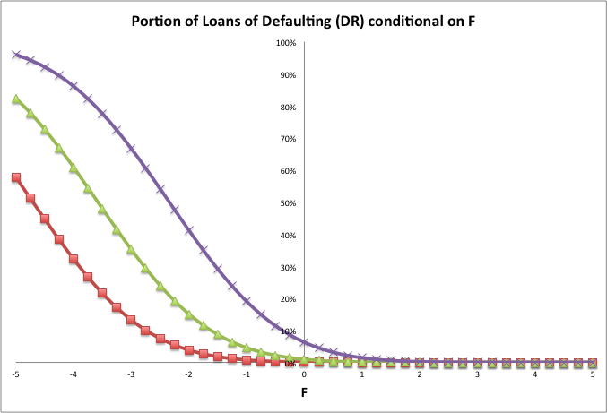
PD=10%
PD=2.5%
ρ=0.3
PD=0.5%

Slide 19
Closed Form Solution cont.
F is the state variable (e.g. condition of the economy), when it’s high the probability of default is low.
The X% worst case is when F is N⁻¹(1−X)=−N⁻¹(X)
For example, 99% worst case is when F=N⁻¹(0.01)=−N⁻¹(0.99)
The worst case default rate with a confidence level of X is therefore:

Slide 20
PD=10%
PD=2.5%
ρ=0.3
PD=0.5%
F=−N⁻¹(0.99)=−2.326

Slide 21
Credit VaR Formula
The Unexpected Loss (UL) Credit VaR in Dollars is:
where L is loan principal and LGD is loss given default, WCDR based on previous formula.

Slide 22
Credit VaR Example
A bank has a total of $100 million of loans, each exposure is small in relation to the total portfolio. The one-year probability of default (PD) for each loan is 2% and the loss given default (LGD) for each loan is 40%. The copula correlation parameter ρ is 0.1.
What is Worst Case Default Rate (WCDR) at 99.9%?
What is Unexpected Loss VaR_{99%}?

Slide 23
Credit VaR Example

Slide 24
Gordy’s Result
In a large portfolio of M loans where each loan is small in relation to the size of the portfolio it is approximately true that
Note that: loan size, probability of default and loss given default can vary between loans.

Slide 25
RBS Asset Protection Scheme
In 2009, Royal Bank of Scotland (RBS) was bailed out by the UK government using an Asset Protection Scheme (APS).
$325B of the Bank’s assets (i.e. loans and bonds) were placed in the scheme. RBS would be liable for the first $19.5B of losses on the portfolio, and the government would be liable for the rest. Assume every asset is a small part of the portfolio.
Suppose the Probability of Default (PD) of each asset is 1% and the Loss Given Default (LGD) is 100%. The copula correlation is 0.4. What is the probability that the government will have to pay anything?

Slide 26
RBS Asset Protection Scheme
Call x the probability of losing $19.5B or less on the portfolio. We are looking for 1-x:

Slide 27
RBS Asset Protection Scheme
What if the loan defaults were independent of each other, and there were 1000 loans?
If the loans were independent there would be almost no chance of the government paying out!

Slide 28
What does simulation get us?
Using simulation we can address specific features of the portfolio
Size Concentration
Industry/Sector Concentration
Mark to Market VaR vs. Default VaR
LGD Simulation
Expected Shortfall

Slide 29
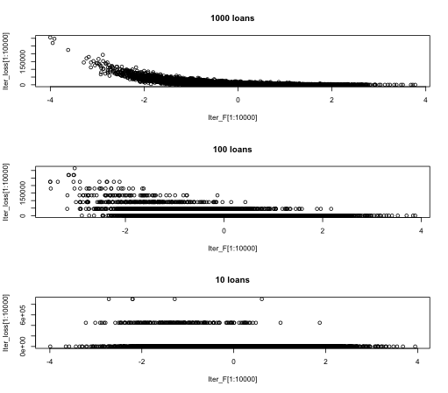

Slide 30
Industry/Sector
Use multiple factors instead of one
For example, 2 factors will lead to every loan variable being generated as:
Common choice for factors are equity indices
Credit Metrics uses MSCI indexes
F₁ and F₂ are correlated Normal variables, with mean zero. Z_{i} are independent of Fs and other Z_{i}.

Slide 31
Sector Concentration - Example
Estimate the correlation matrix for the factors.
Regress equity returns on the factors to get betas
σ²_{XYZ} is the total variance, R²_{XYZ} out of it is due to the factors, while 1-R²_{XYZ} is due to idiosyncratic risk.

Slide 32
Sector Concentration - Example
Simulate factors as correlated mean-zero Normals and simulate idiosyncratic as uncorrelated
F₁, F₂ for example are indexes: Germany:Banking and Germany:Insurance
Coefficients are set so variance due to Factors is R²_{XYZ}. Leading to U_{XYZ} being standard normal.
As before, count as default if

Slide 33
Mark-to-Market VaR
So far, we modeled losses due to default only.
At the end of the period some credits may be downgraded or upgraded. This will affect their price.
Bondholders may be concerned with the MTM of the bond at the end of the period, rather than loss to default.
In fact, loan holders too are interested in changes in the ratings, because the model is quantifying one period losses, whereas the loan maturities are longer.

Slide 34
One-Year Rating Transition Matrix (% probability, Moody’s 1970-2010)
Initial
Rating at year end
Rating
Aaa
Aa
A
Baa
Ba
B
Caa
Ca-C
Default
Aaa
90.42
8.92
0.62
0.01
0.03
0.00
0.00
0.00
0.00
Aa
1.02
90.12
8.38
0.38
0.05
0.02
0.01
0.00
0.02
A
0.06
2.82
90.88
5.52
0.51
0.11
0.03
0.01
0.06
Baa
0.05
0.19
4.79
89.41
4.35
0.82
0.18
0.02
0.19
Ba
0.01
0.06
0.41
6.22
83.43
7.97
0.59
0.09
1.22
B
0.01
0.04
0.14
0.38
5.32
82.19
6.45
0.74
4.73
Caa
0.00
0.02
0.02
0.16
0.53
9.41
68.43
4.67
16.76
Ca-C
0.00
0.00
0.00
0.00
0.39
2.85
10.66
43.54
42.56
Default
0.00
0.00
0.00
0.00
0.00
0.00
0.00
0.00
100.00

Slide 35
Simulating Transitions
CreditMetrics Technical Document 1997

Slide 36
Credit Metrics MTM VaR
Simulate for every loan:
Determine the loan’s new ratings based on the standard normal cut-off points
Re-price the loan with the credit spreads for the new rating
Forwards for interest rates and credit spreads have to be used
Sum up all loan values for one possible portfolio MTM at the end of period.

Slide 37
MTM Example for One Bond
Consider a 5-year, A-rated bond, paying 6% coupon.
Simulate U_{i} a standard Normal, and determine the new ratings based on the transition matrix:
End of Year Rating | Probability (%) | Cum Prob (%) | lower bound | upper bound
Aaa | 0.06 | 100 | 3.239 | ∞
Aa | 2.82 | 99.94 | 1.899 | 3.239
A | 90.88 | 97.12 | -1.535 | 1.899
Baa | 5.52 | 6.24 | -2.447 | -1.535
Ba | 0.51 | 0.72 | -2.863 | -2.447
B | 0.11 | 0.21 | -3.090 | -2.863
Caa | 0.03 | 0.1 | -3.195 | -3.090
Ca-C | 0.01 | 0.07 | -3.239 | -3.195
D | 0.06 | 0.06 | -∞ | -3.239

Slide 38
MTM Example Cont.
Use the forward curves for each rating to revalue the bond:
For example, if it stays A

Slide 39
MTM VaR (cont)
X% Worst Case (XWC)
Mean Horizon Value (MHV)
VaR^{UL}
VaR^{UL} = MHV – XWC
EL = CV - MHV
EL
Current Value
Sum all bond values to create an end of period distribution for portfolio value.

Slide 40
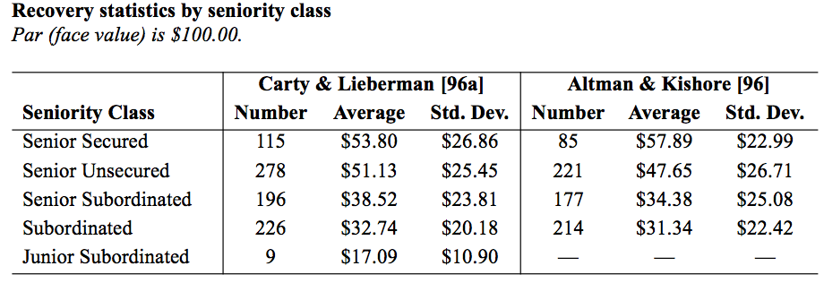
Credit Metrics Incorporating LGD
Recovery rates have wide variation
Low recovery rates are correlated with high PD over time and industry
CreditMetrics Technical Document 1997

Slide 41
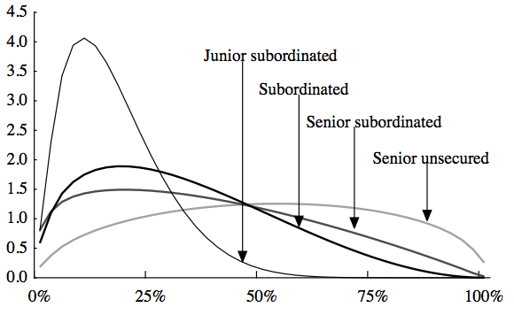
Incorporating LGD cont.
Credit Metrics samples Recovery from Beta distribution
bounded between 0 and 1.
fitted based on empirical studies.
More complex simulations can correlate Recovery to PDs

Slide 42
Basel II – Internal Rating Based Approach
Capital requirement is based on 99.9% worst case default rate using Normal copula:
– correlation between two exposures
- depends on PD and the type of exposure (corporate, SMB, retail, mortgage)

Slide 43
Capital Requirements

Slide 44
Capital Requirements
Requirements are calculated exposure by exposure and summed up
MA formula was approximated by comparing a MTM simulation to Default only case
Portfolio features like size concentration or industry concentration are NOT taken into account
Banks use internal Credit VaR models to approximate the additional capital required for these features
This process is called ICAAP

Slide 45
Thanks

